Slide 1
DON Executive Onboarding
Overview
Regan Anderson
Executive Management Program Office
June 14, 2011

Slide 2
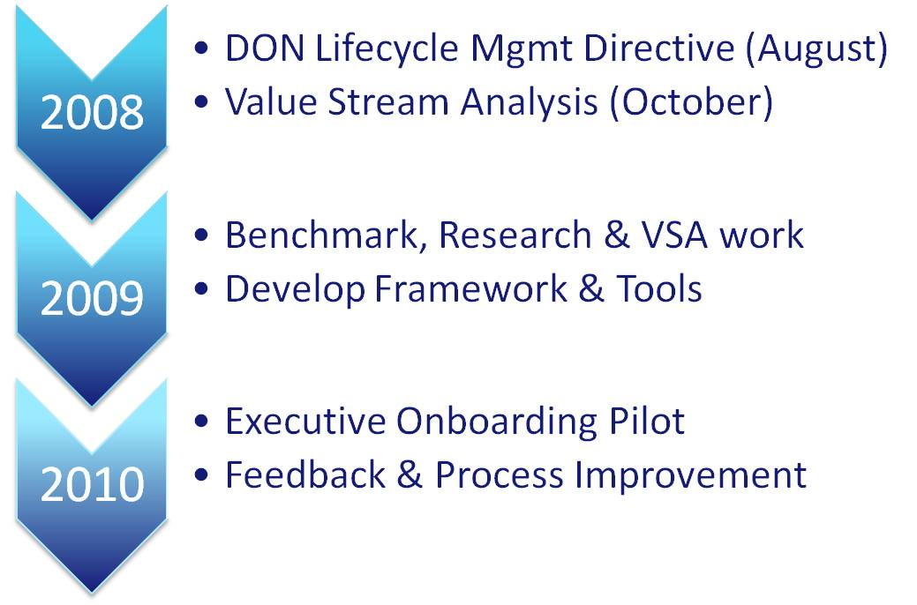
Background

Slide 3




Executive Onboarding Program
Strategic Objectives
Executive Lifecycle
Establish and implement onboarding program as an important lever of the Executive Lifecycle
Build and sustain high performance executive culture by accelerating assimilation in first weeks and months on the job
Create set of integrated processes, activities and services to help executives make rapid transitions and deliver on DON mission
Instill departmental appreciation and commitment to Total Force by helping executives understand the culture, identify stakeholders and establish areas of influence
Provide standard learning & development curriculum at entry to support newly appointed executives
Accelerate performance effectiveness with use of coaches, mentors and strategic networks
Ensure competitive advantage by promoting executive retention, engagement and long-term success
Workforce
Planning
Onboarding
Leadership Development
Sourcing, Recruiting, Selecting
Mission and Organizational Goals
Core Competencies
and Values
Separation & Sustainment
Performance Management
Culture
Succession Management
Compensation

Slide 4
Onboarding Program: At A Glance*
Initiated by Selecting Official and Command POC in partnership with EMPO
Before Selection is Made – Interview onsite to review mission, vision, job & tour organization
Command Makes Selection – Processes to Complete Before Day 1
(1) Offer letter/Welcome handbook (2) Security/Drug Test (3) Set up office, computer and phone (4) Assign Sponsor/Peer Advisor (5) Contact Employee for Q&A (6) Schedule office visit and meet-n-greet with Execs/Staff (7) Communicate required Executive learning curriculum
Day 1
1st Week
First 30 days
First 90 days
1st Year
Day 1
1st Week
First 30 days
First 90 days
1st Year
Senior Leader welcomes Exec
Deep dive on mission, org
Meeting to complete in-processing/benefits
Security/badge processing
Introduce new exec to sponsor/peer advisor
Provide key stakeholder list
Lunch with other Execs/Senior Military Leadership
Exec is introduced to staff & senior coworkers
Supervisor/Exec review org structure/ key staff
Supervisor/Exec review of roles and responsibilities
Provide protocol training
Supervisor provides highlights of Accelerating Leadership Transitions workshop
Review SES Competency Model
Set/Review performance objectives
Review list of required/recommended learning (NFLEX, OPM SES Briefing, etc.)
Explore/Set development goals
Discuss Mentor matching
Discuss broader exec development
Confirm appropriate systems access (Succession Management, etc.)
Ethics counselor meeting
Onboarding Questionnaire
Exec schedules meetings with stakeholders
Exec seeks/provides performance feedback
Executive Coaching
Exec continues with mentorship
Exec has recurring check-in with sponsor
New Leader Assimilation (future)
Onboarding Questionnaire
Ongoing learning & development
Exec broadens networks
Succession Management role/responsibilities
Exec assesses performance and provides feedback
Remind Exec at 6 & 12 month mark to conduct performance reviews
Onboarding Questionnaire: 6 & 12 mos.
Prepare Enable Support Engage
*List illustrates sampling of key activities, processes and services at each interval

Slide 5
Program Measurement
Measure | Metric
Understanding of my department’s objectives and overall structure | Employee Evaluations
Understanding of my Command’s objectives and overall structure | Employee Evaluations
Understanding of the DONs objectives and overall structure | Employee Evaluations
Understanding of how my work aligns to DON Mission | Employee Evaluations
Forming of relationships and expansion of network | Use of Mentor Executive Coach/ Competencies/360 Assessment Learning/Development/Networking events attended
Extent to which executive achieves results | Performance Ratings Awards/Recognition received Invitations to join Joint Task Forces Special Advisor roles Special Assignments offered
Four Evaluation Points: 30 days, 90 days, 6 months and 1 year

Slide 6
Lessons Learned from Pilot/Reinforcement
Selecting official/supervisor engagement is important
  Generals/Flag Officers
  SES
Tailor onboarding experience
  Internal vs. external promotion
  Multiple executive positions call for different needs
Connect with new executives on a regular basis
Automate where it makes sense

Slide 7
Ad-hoc and Periodic Offerings
Town Hall Meetings
Lunch with the Under Secretary of the Navy
Senior Executive Seminar
Flash Mentoring

Slide 8
Coming in FY12: 21st Century Leadership
Department of the Navy Executive Leadership Program
Capability
21st Century Leadership (Part I)
5-day classroom program
21st Century Leadership (Part II)
Apply and reinforce classroom program content while solving a “vexing” DON problem with a cohort group; teams receive problem charter from DON top executive(s)
Obtain 360 feedback regarding leadership competence & potential
Obtain feedback from executive coach, sponsor, and peers regarding leadership demonstrated as a team member in the group project
Action learning program concurrent with day job (4-6 classroom days over 3-6 month period)
Enhance personal leadership competence while building “one department” DON community and strengthening commitment to Navy and Marine Corps greatness
Self
Community
Others
Commitment
Organization

Slide 9
Questions?
Contact Information:
Regan Anderson
Talent Management Program Manager
Executive Management Program Office, OCHR
202-685-1100
regan.anderson@navy.mil
DON HR Public Web site: http://www.public.navy.mil/donhr/executivemanagement/ExecutiveOpportunitiesandRecruitment/Pages/Onboarding.aspx

